Slide 1
登机与离机策略的最优化讨论 The Optimal Boarding & Disembarking Method
IMMC 22768821
上海市实验学校 Shanghai Experimental School

Slide 2
背景 Background
时间和效率在飞机运行过程中起到重要作用。在一般的飞行中，登机和离机的时间消耗占据了机前准备的很大一部分。因此，为登机和离机的过程与特殊机型和突发状况制定最佳方案十分重要。
Time and efficiency play a vital role in air transportation. For routine passenger flights, sections that require a significant amount of time include the boarding and disembarking of passengers. Therefore, it's necessary to build a model which provides the best strategy for different types of planes and on various occasions.

Slide 3
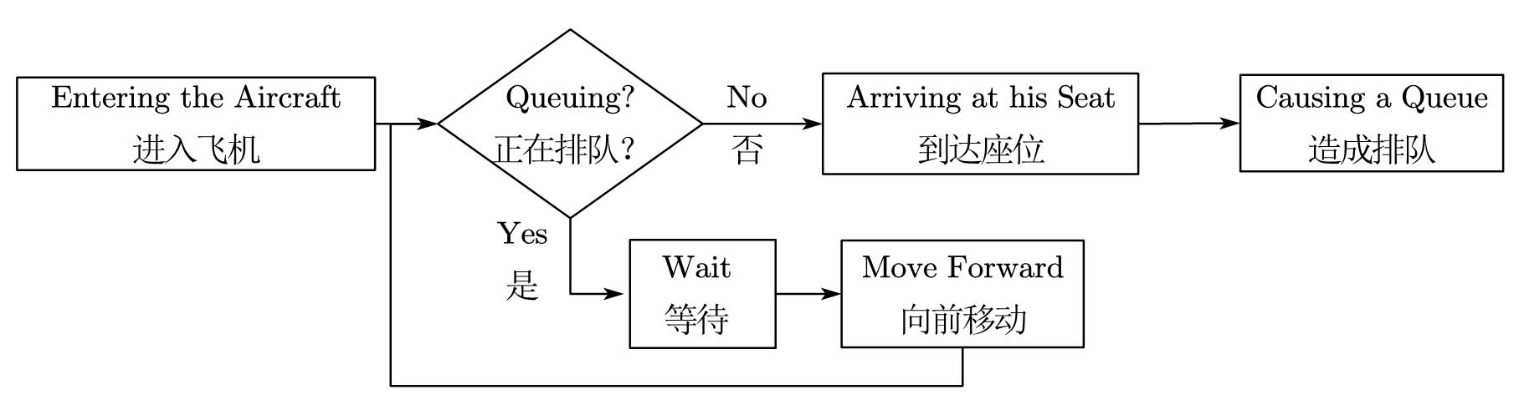
背景 Background

Slide 4
任务分割 Our Work
设计出一个可以计算出登机离机时间且可以应用于所有机型的模型。
Design a model that can calculate the time required to board and disembark, which can be applied to all kinds of planes.
在考虑不同情况，乘客满意度和突发状况的情况下优化模型，并根据模型结果初步制定出完整方案。
Improve the model considering different situations, satisfaction degree of passengers and emergency events and design a straightforward strategy based on the results of our model.
将我们的模型应用于真实飞机上，找到使登离机时间最小化的方案。
Apply our model to real-life planes and find out the best strategy which minimises the boarding and disembarking time.

Slide 5
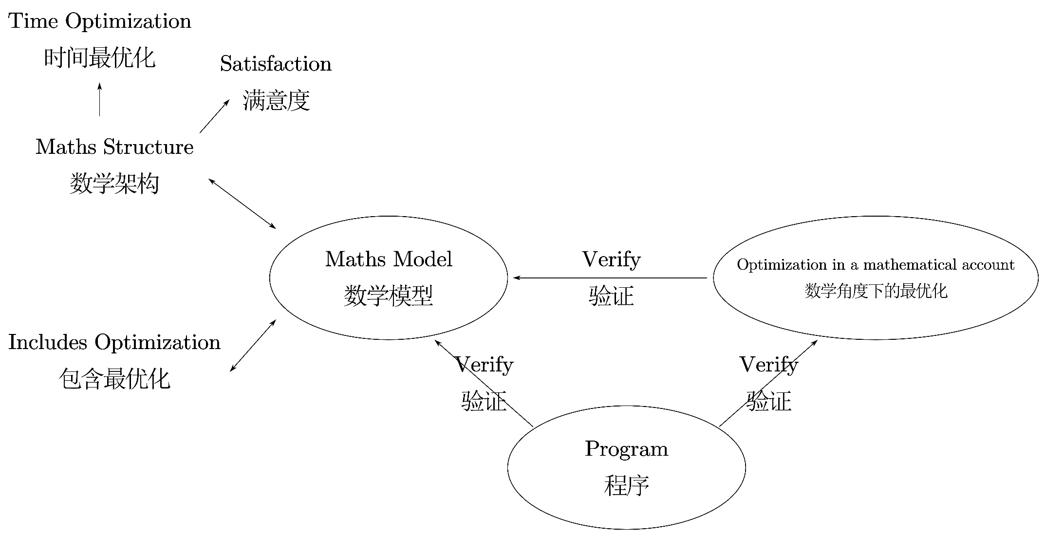
模型结构 Model Structure
图 本模型的结构
Fig. The structure of our model

Slide 6
总假设 General Assumptions
每名乘客都会将自己的行李放在自己座位的正上方。
For each passenger, their luggage is put on the rack above them.
所有乘客的取行李和放行李的标准时间都相同。
For a specific passenger, the time to lay down his luggage and remove it is the same.
过道的宽度恰好能容纳一名乘客。
The total width of a passenger and his luggage is similar to the width between rows.
为了提供乘客最好的飞行体验，航空公司需要找到一个既能满足乘客需要又能最大化载客量的列间距。
To provide the passengers with the best flying experience, the airline company needs to find a width between rows that will satisfy the needs of people and maximise the plane’s capacity.
这可以把连续模型变为离散的并简化计算。
This can turn the continuous model into a discrete model to simplify the calculation.

Slide 7
总假设 General Assumptions
所有乘客在过道中的最大速度相等。
All passengers walk at the same speed on the aisles.
乘客只会朝着自己座位的方向移动，而不会往回走。
Passengers never go backwards.
头等舱和商务舱乘客会优先登机。
First and business class passengers are prioritised with respect to those of the economic class.
乘客给其他乘客让座时的横移速度等于其在过道中的最大速度。
The horizontal velocity of passengers offering seats is equal to the maximum speed in the aisle.

Slide 8
时间计算 - 假设 Assumptions for Time Calculating
行李架足够大，能容纳任意大小的行李。
The luggage racks are designed to be adequate for any reasonable amount of luggage.
每名乘客能携带的行李量有限
There’s a limit on the amount of luggage each passenger can bring
把行李放在行李架上和把行李挤到座位里在时间上相等
Passengers spend the same time putting luggage into the rack as putting the luggage into the seat
乘客每时每刻会以其当时可能达到的最大速度行走。
Passengers always maintain their maximum theoretical speed at that time.
乘客一般会尽快就座，因此合理的假设是乘客总以可能的最大速度行进。
Passengers usually want to get seated as quickly as possible, so it’s reasonable to assume that passengers always walk as quickly as possible.

Slide 9
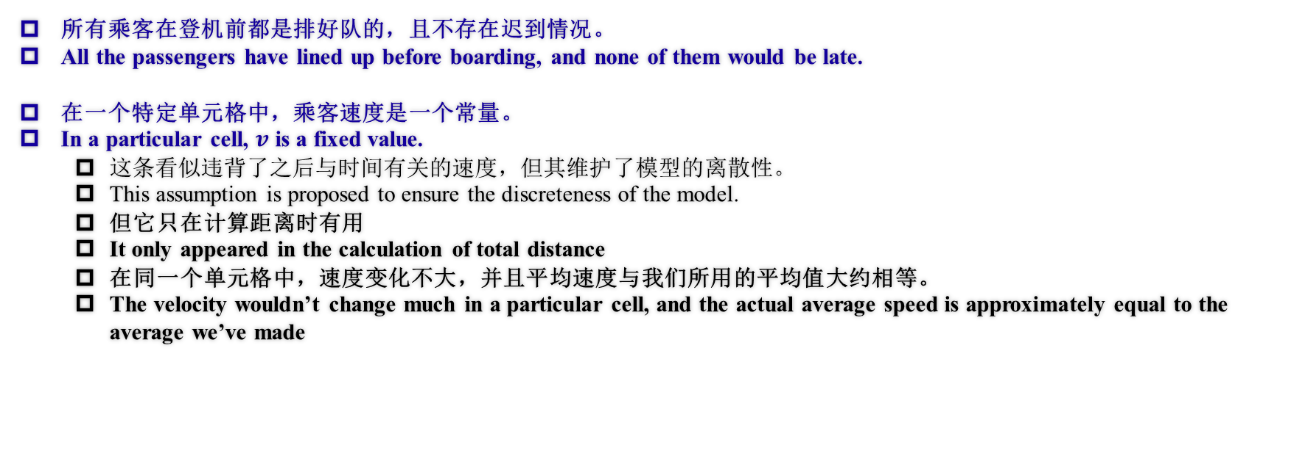
时间计算 - 假设 Assumptions for Time Calculating
所有乘客在登机前都是排好队的，且不存在迟到情况。
All the passengers have lined up before boarding, and none of them would be late.
在一个特定单元格中，乘客速度是一个常量。
In a particular cell, $v$ is a fixed value.
这条看似违背了之后与时间有关的速度，但其维护了模型的离散性。
This assumption is proposed to ensure the discreteness of the model.
但它只在计算距离时有用
It only appeared in the calculation of total distance
在同一个单元格中，速度变化不大，并且平均速度与我们所用的平均值大约相等。
The velocity wouldn’t change much in a particular cell, and the actual average speed is approximately equal to the average we’ve made

Slide 10
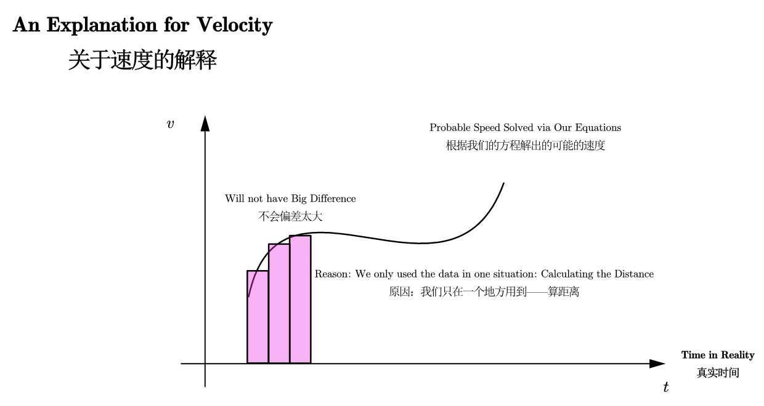
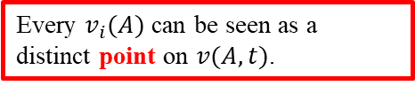
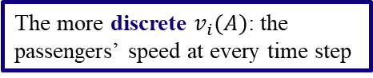
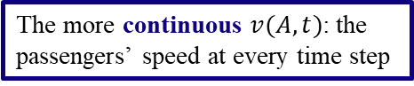
假设的解释 Justification for the Assumption
关于最后一条假设的解释
The explanation for the last assumption made in the previous slide
The more continuous $v(A,t)$: the passengers’ speed at every time step
The more discrete $v_{i}(A)$: the passengers’ speed at every time step
Every $v_{i}(A)$ can be seen as a distinct point on $v(A,t)$.
Therefore, the summation (or integral) of these two defined velocities will roughly amount to the same value.

Slide 11
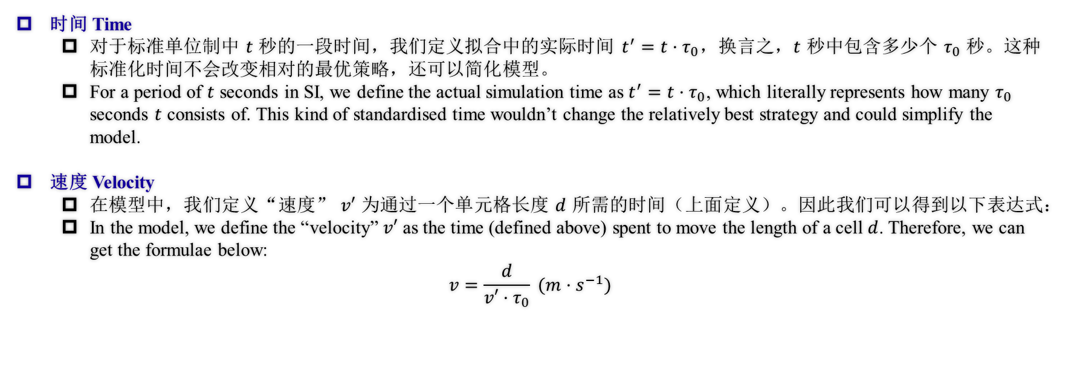
定义 Definitions
时间 Time
对于标准单位制中 $t$ 秒的一段时间，我们定义拟合中的实际时间 $t^{′}=t·τ_{0}$，换言之，$t$ 秒中包含多少个 $τ_{0}$ 秒。这种标准化时间不会改变相对的最优策略，还可以简化模型。
For a period of $t$ seconds in SI, we define the actual simulation time as $t^{′}=t·τ_{0}$, which literally represents how many $τ_{0}$ seconds $t$ consists of. This kind of standardised time wouldn’t change the relatively best strategy and could simplify the model.
速度 Velocity
在模型中，我们定义“速度” $v′$ 为通过一个单元格长度 $d$ 所需的时间（上面定义）。因此我们可以得到以下表达式：
In the model, we define the “velocity” $v′$ as the time (defined above) spent to move the length of a cell $d$. Therefore, we can get the formulae below:
$$v=\frac{d}{v′·τ_{0}} (m·s^{−1})$$

Slide 12
变量表 Notations
Constant A: won’t change in the whole scope.
Constant B: may change in the whole scope, but won’t change for a fixed set of passengers and a set plane.
Variable: varies for different initial sequences of passengers.
常量A：在整个过程中不会变化。
常量B：在整个过程中会变化，但对于一个乘客群体不会变化。
变量：随着时间变化而改变。
Notes:
如ppt所言

Slide 13
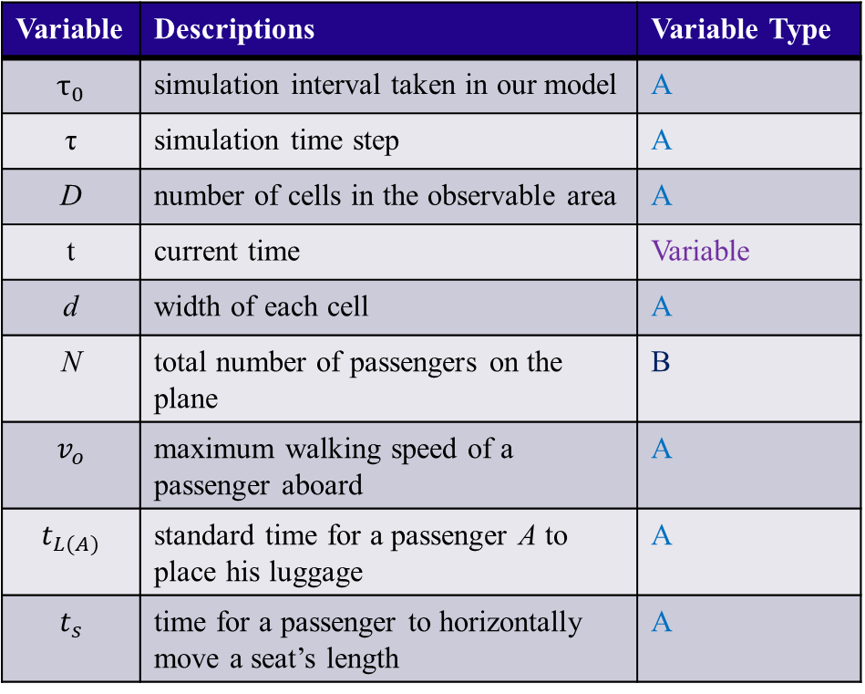
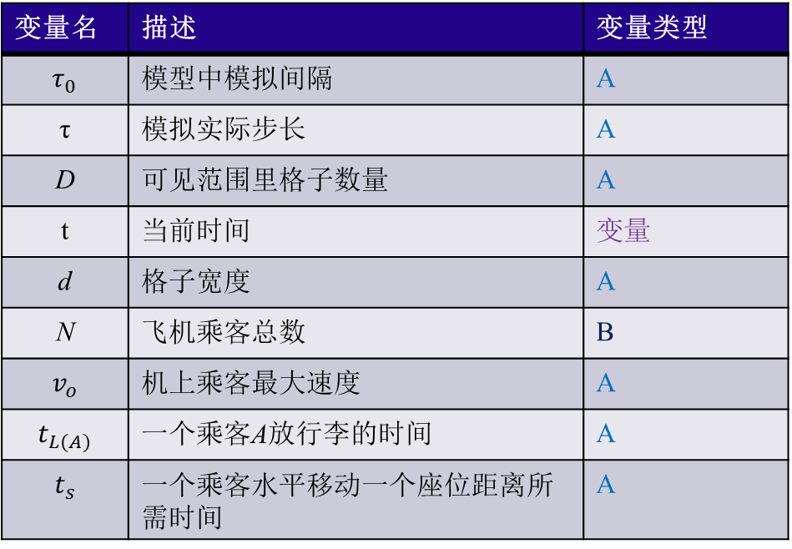
变量表 Notations
Variable | Descriptions | Variable Type
$$τ_{0}$$ | simulation interval taken in our model | A
τ | simulation time step | A
D | number of cells in the observable area | A
t | current time | Variable
d | width of each cell | A
N | total number of passengers on the plane | B
$$v_{o}$$ | maximum walking speed of a passenger aboard | A
$$t_{L(A)}$$ | standard time for a passenger A to place his luggage | A
$$t_{s}$$ | time for a passenger to horizontally move a seat’s length | A
变量名 | 描述 | 变量类型
$$τ_{0}$$ | 模型中模拟间隔 | A
τ | 模拟实际步长 | A
D | 可见范围里格子数量 | A
t | 当前时间 | 变量
d | 格子宽度 | A
$$\text{N}$$ | 飞机乘客总数 | B
$$v_{o}$$ | 机上乘客最大速度 | A
$$t_{L(A)}$$ | 一个乘客A放行李的时间 | A
$$t_{s}$$ | 一个乘客水平移动一个座位距离所需时间 | A

Slide 14
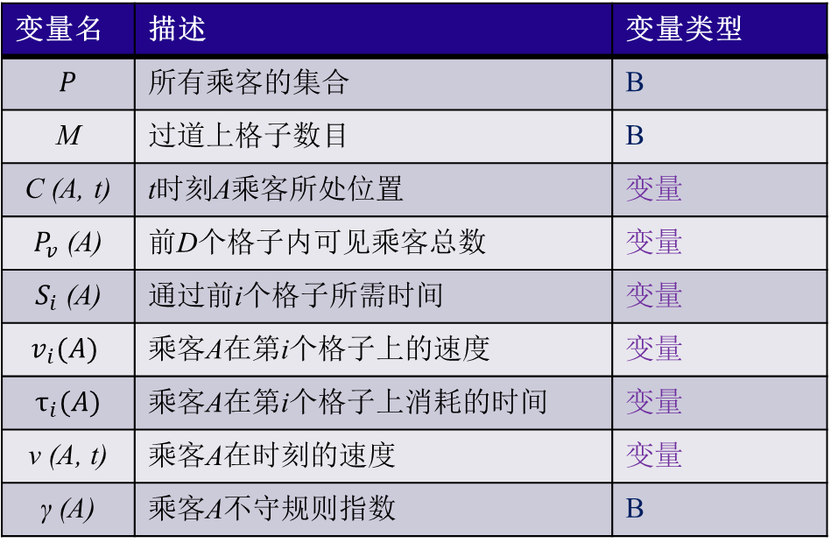
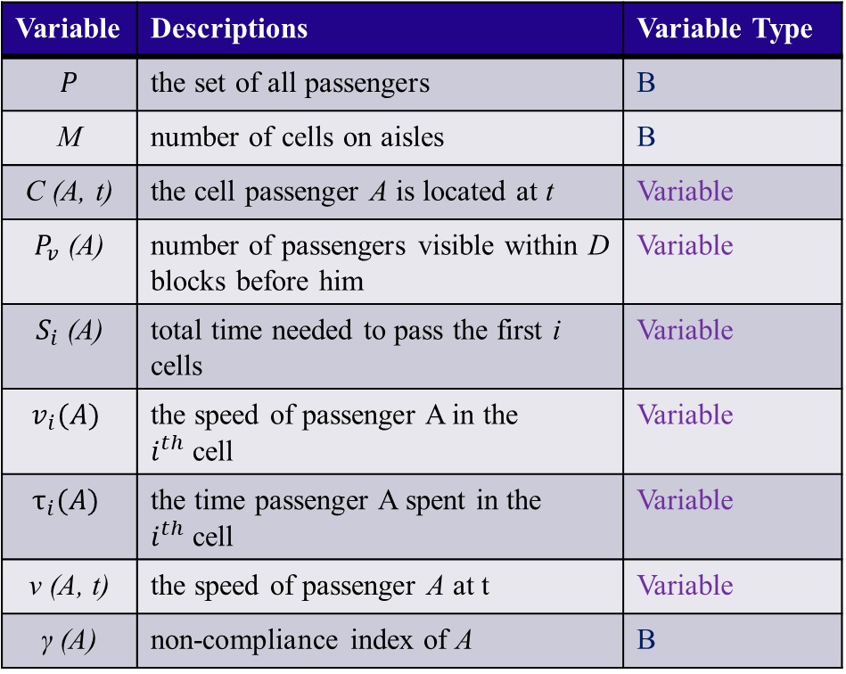
变量表 Notations
Variable | Descriptions | Variable Type
$$P$$ | the set of all passengers | B
M | number of cells on aisles | B
C (A, t) | the cell passenger A is located at t | Variable
$P_{v}$ (A) | number of passengers visible within D blocks before him | Variable
$S_{i}$ (A) | total time needed to pass the first i cells | Variable
$$v_{i}(A)$$ | the speed of passenger A in the $i^{th}$cell | Variable
$$τ_{i}(A)$$ | the time passenger A spent in the $i^{th}$cell | Variable
$$\text{v}\text{ (}\text{A}\text{, }\text{t}\text{)}$$ | the speed of passenger A at t | Variable
$$\text{γ}\text{ (}\text{A}\text{)}$$ | non-compliance index of A | B
变量名 | 描述 | 变量类型
$$P$$ | 所有乘客的集合 | B
M | 过道上格子数目 | B
C (A, t) | t时刻A乘客所处位置 | 变量
$P_{v}$ (A) | 前D个格子内可见乘客总数 | 变量
$S_{i}$ (A) | 通过前i个格子所需时间 | 变量
$$v_{i}(A)$$ | 乘客A在第i个格子上的速度 | 变量
$$τ_{i}(A)$$ | 乘客A在第i个格子上消耗的时间 | 变量
$$\text{v}\text{ (}\text{A}\text{, }\text{t}\text{)}$$ | 乘客A在时刻的速度 | 变量
$$\text{γ}\text{ (}\text{A}\text{)}$$ | 乘客A不守规则指数 | B

Slide 15
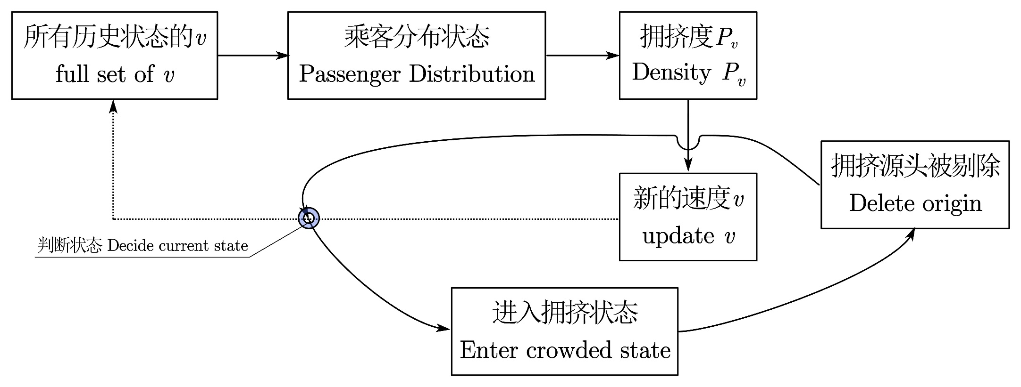
模型总览 Overview of Our Model
图 模型总览
Fig. Overview of our model

Slide 16
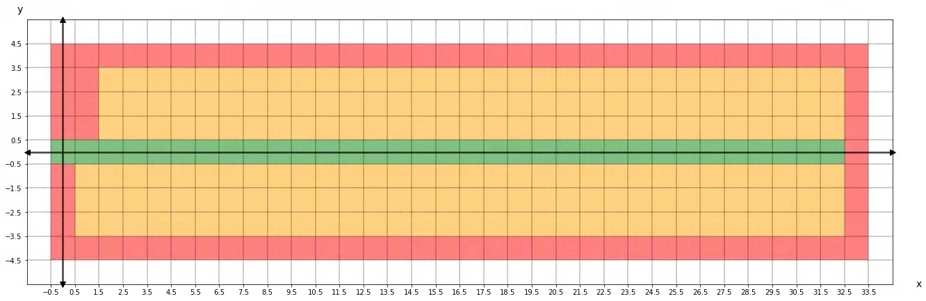
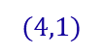
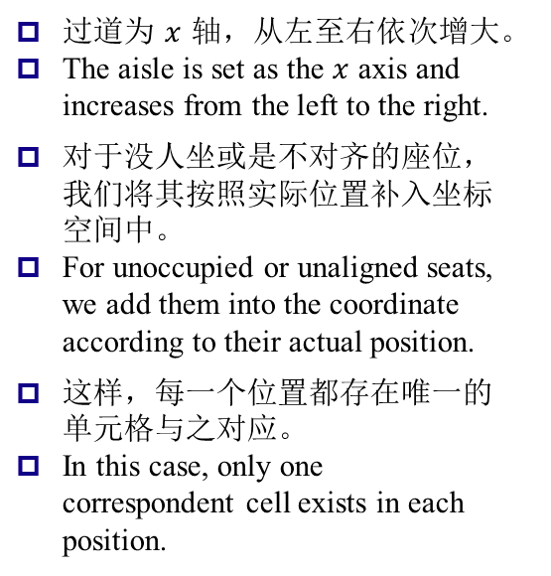
构建数学模型计算登机时间（常规状态） Devising a Model to Calculate Total Boarding Time (Under Regular States)
这一部分中，我们将采用逐步推演的方式较为清晰地展示乘客速度之间的关系。
In this part, we’ll carefully deduct and explicitly display the connections between the passengers’ velocities.
坐标系的构建 - The construction of the coordinate
过道为$x$轴，从左至右依次增大。
The aisle is set as the $x$ axis and increases from the left to the right.
对于没人坐或是不对齐的座位，我们将其按照实际位置补入坐标空间中。
For unoccupied or unaligned seats, we add them into the coordinate according to their actual position.
这样，每一个位置都存在唯一的单元格与之对应。
In this case, only one correspondent cell exists in each position.
$$(4,1)$$
Cell 1
Cell 2
图 坐标系的构建
Fig. The construction of the coordinate
比如该墙体仍然被当作坐标格处理
For example, this wall is still taken as several cells.

Slide 17
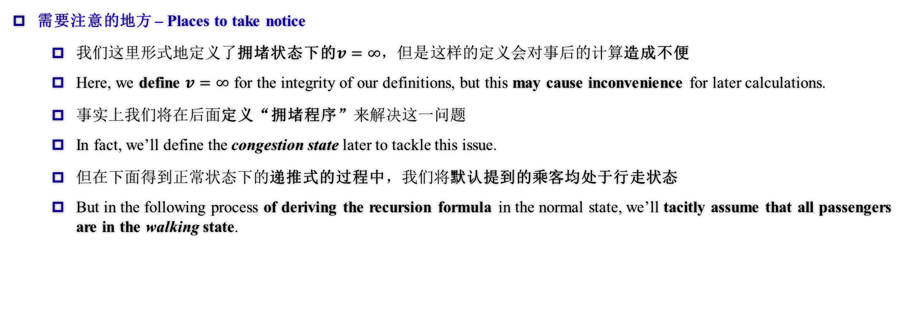
构建数学模型计算登机时间（常规状态） Devising a Model to Calculate Total Boarding Time (Under Regular States)
需要注意的地方 – Places to take notice
我们这里形式地定义了拥堵状态下的$v=∞，但是$这样的定义会对事后的计算造成不便
Here, we define $v=∞$ for the integrity of our definitions, but this may cause inconvenience for later calculations.
事实上我们将在后面定义“拥堵程序”来解决这一问题
In fact, we’ll define the congestion state later to tackle this issue.
但在下面得到正常状态下的递推式的过程中，我们将默认提到的乘客均处于行走状态
But in the following process of deriving the recursion formula in the normal state, we’ll tacitly assume that all passengers are in the walking state.

Slide 18
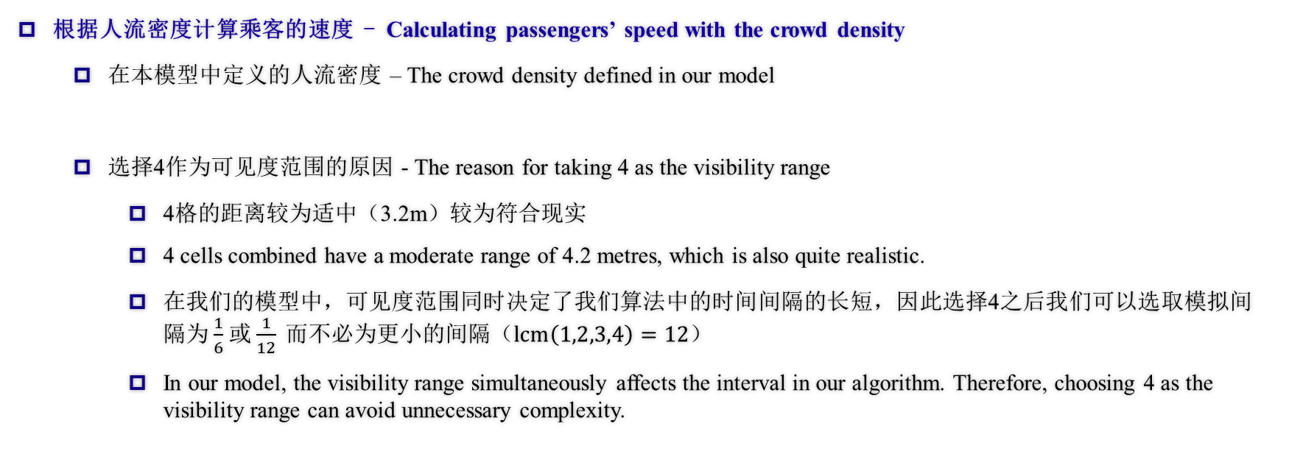
构建数学模型计算登机时间（常规状态） Devising a Model to Calculate Total Boarding Time (Under Regular States)
根据人流密度计算乘客的速度 - Calculating passengers’ speed with the crowd density
在本模型中定义的人流密度 – The crowd density defined in our model
选择4作为可见度范围的原因 - The reason for taking 4 as the visibility range
4格的距离较为适中（3.2m）较为符合现实
4 cells combined have a moderate range of 4.2 metres, which is also quite realistic.
在我们的模型中，可见度范围同时决定了我们算法中的时间间隔的长短，因此选择4之后我们可以选取模拟间隔为$\frac{1}{6}$或$\frac{1}{12} 而$不必为更小的间隔（$lcm\left(1,2,3,4\right)=12$）
In our model, the visibility range simultaneously affects the interval in our algorithm. Therefore, choosing 4 as the visibility range can avoid unnecessary complexity.

Slide 19
构建数学模型计算登机时间（常规状态） Devising a Model to Calculate Total Boarding Time (Under Regular States)
根据人流密度计算乘客的速度 - Calculating passengers’ speed with the crowd density
格林希尔茨（Greenshields）速度-人流密度线性关系模型（论文中引用3）
Greenshields speed-density linear model (Ref. 3 in the essay)

Slide 20
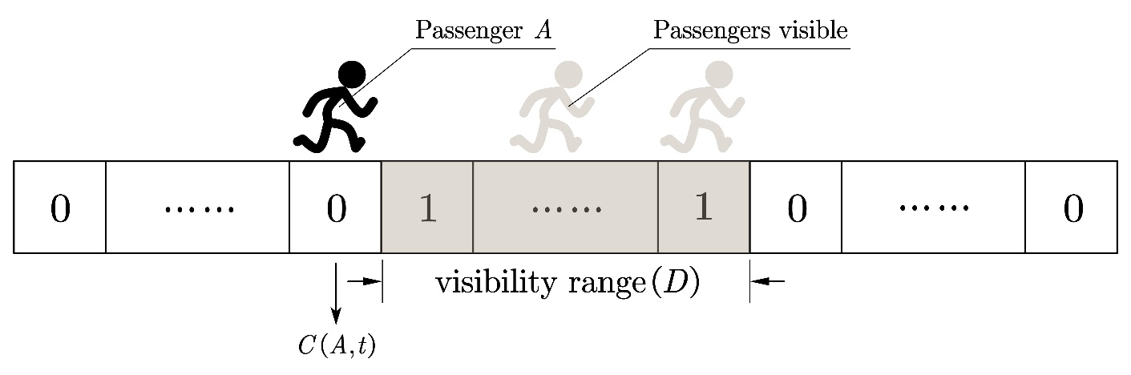
构建数学模型计算登机时间（常规状态） Devising a Model to Calculate Total Boarding Time (Under Regular States)
根据乘客分布计算人流密度 – Calculating crowd density under a given passenger distribution
由两个分别代表乘客“能见度”与过道中乘客状态分布的向量数乘得到
Calculated through the dot product of two vectors representing the passenger’s visibility and the overall distribution in the aisle. (or the existence factor)
这样，我们得到了乘客能见度与乘客分布的线性积关系。
In this case, we’ve got the linear product relation between visibility and the overall crowd distribution.
图 两个向量的直观表示
Fig. The intuitive illustration of the visibility and existence vectors

Slide 21
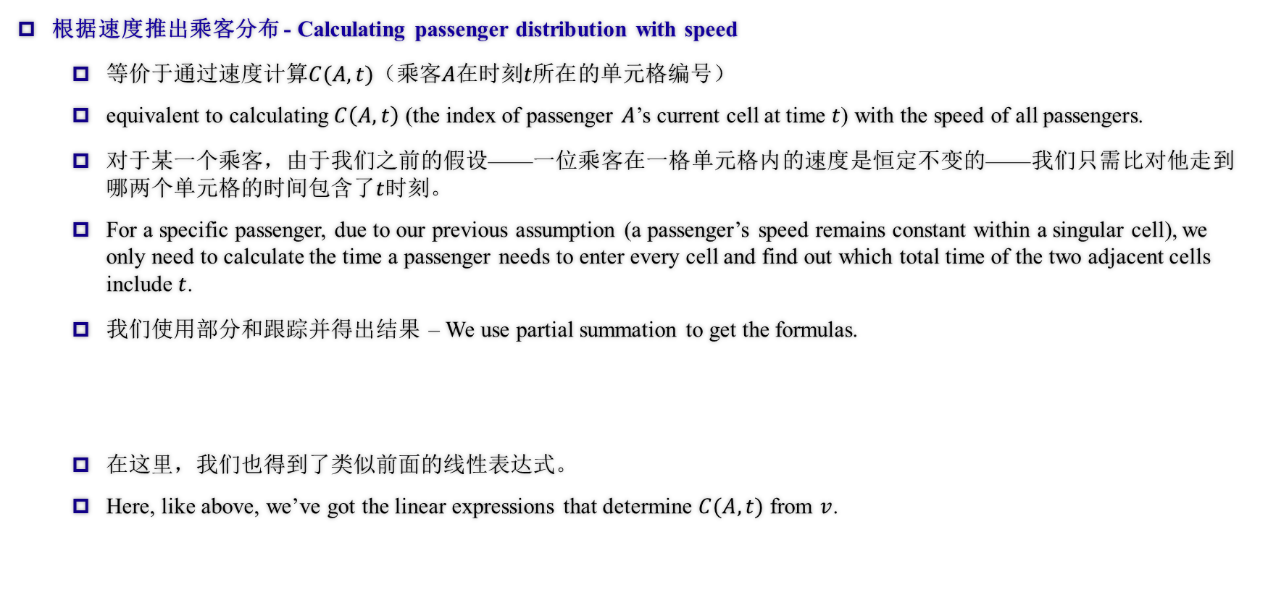
构建数学模型计算登机时间（常规状态） Devising a Model to Calculate Total Boarding Time (Under Regular States)
根据速度推出乘客分布 - Calculating passenger distribution with speed
等价于通过速度计算$C(A,t)$（乘客$A$在时刻$t所在$的单元格编号）
equivalent to calculating $C\left(A,t\right)$ (the index of passenger $A$’s current cell at time $t$) with the speed of all passengers.
对于某一个乘客，由于我们之前的假设——一位乘客在一格单元格内的速度是恒定不变的——我们只需比对他走到哪两个单元格的时间包含了$t$时刻。
For a specific passenger, due to our previous assumption (a passenger’s speed remains constant within a singular cell), we only need to calculate the time a passenger needs to enter every cell and find out which total time of the two adjacent cells include $t$.
我们使用部分和跟踪并得出结果 – We use partial summation to get the formulas.
在这里，我们也得到了类似前面的线性表达式。
Here, like above, we’ve got the linear expressions that determine $C(A,t)$ from $v$.

Slide 22
构建数学模型计算登机时间（常规状态） Devising a Model to Calculate Total Boarding Time (Under Regular States)
总结——我们得到的递推式 – The overall recursion formula we get
我们的模型一直到“更新速度”这一层都是线性的，而根据真实速度与模型中速度的反比关系，我们将会得到一个线性模型。（这一部分将会在之后的敏感度分析中得到验证）
Our model is linear until the final stage (or the first slide presented in this part), so according to the inverse proportional relationship between real-life velocity and the velocity in our model, we’ll get a linear model. (this quality will be verified later in the Sensitivity Analysis part)
因此，我们可以得到下述由前一时刻所有乘客的速度状态组的线性组合得到的线性递推公式。
Therefore, we can get the linear recursion formula with the whole state of passenger velocities as the previous time step, as shown below.

Slide 23
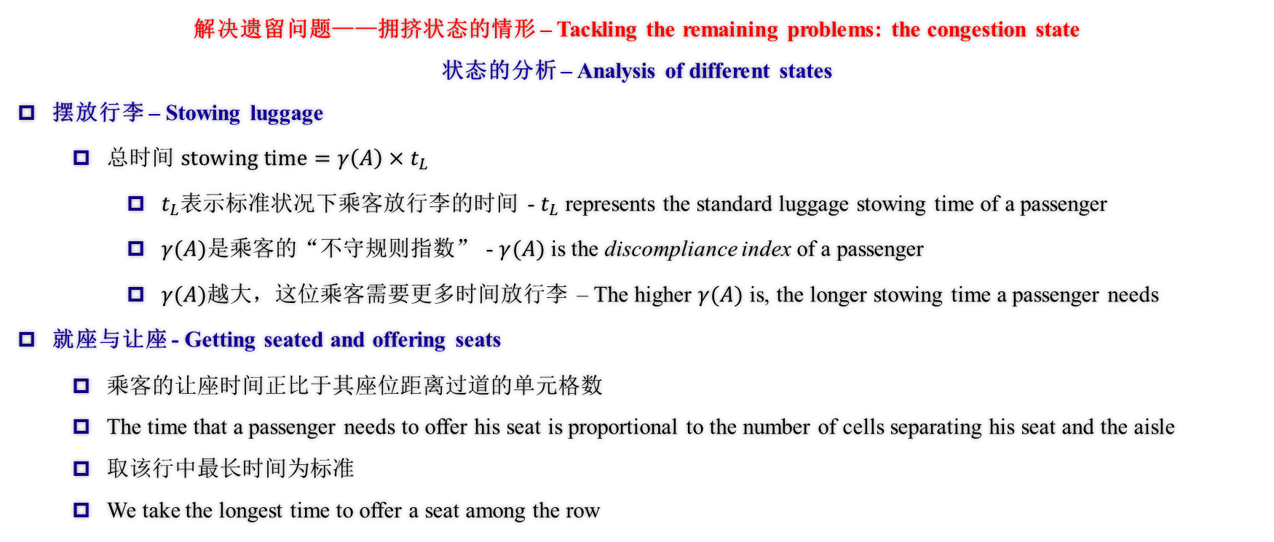
构建数学模型计算登机时间（拥挤状态） Devising a Model to Calculate Total Boarding Time (Under the Crowded States)
解决遗留问题——拥挤状态的情形 – Tackling the remaining problems: the congestion state
状态的分析 – Analysis of different states
摆放行李 – Stowing luggage
总时间 $stowing time=γ\left(A\right)×t_{L}$
$t_{L}$表示标准状况下乘客放行李的时间 - $t_{L}$ represents the standard luggage stowing time of a passenger
$γ(A)$是乘客的“不守规则指数” - $γ(A)$ is the discompliance index of a passenger
$γ(A)$越大，这位乘客需要更多时间放行李 – The higher $γ(A)$ is, the longer stowing time a passenger needs
就座与让座 - Getting seated and offering seats
乘客的让座时间正比于其座位距离过道的单元格数
The time that a passenger needs to offer his seat is proportional to the number of cells separating his seat and the aisle
取该行中最长时间为标准
We take the longest time to offer a seat among the row

Slide 24
构建数学模型计算登机时间（拥挤状态） Devising a Model to Calculate Total Boarding Time (Under the Crowded States)
解决遗留问题——拥挤状态的情形 – Tackling the remaining problems: the congestion state
状态的分析 – Analysis of different states
就座与让座 - Getting seated and offering seats
仔细看来，加入初始状态是确定的，那么让座时间便可以直接通过队列的顺序计算。
Under close inspection, the time to offer seats can be calculated if the original state is given.
对于某一行的乘客，由于不存在超到前面去的情况，到达这一行的乘客从前到后的顺序与他们一开始在队列中的顺序完全相同，因此可以据此事实直接计算。
For passengers in a specific row, since it’s not allowed to surpass anyone before them, the arrival sequence of this row’s passengers is the same as their original position in the queue. Therefore, we can calculate the total time of offering seats directly based on the given queue.

Slide 25
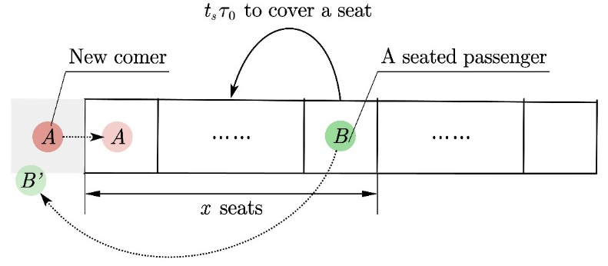
构建数学模型计算登机时间（拥挤状态） Devising a Model to Calculate Total Boarding Time (Under the Crowded States)
解决遗留问题——拥挤状态的情形 – Tackling the remaining problems: the congestion state
状态的分析 – Analysis of different states
就座与让座- Getting seated and offering seats
图 让座程序
Fig. Offering a seat

Slide 26
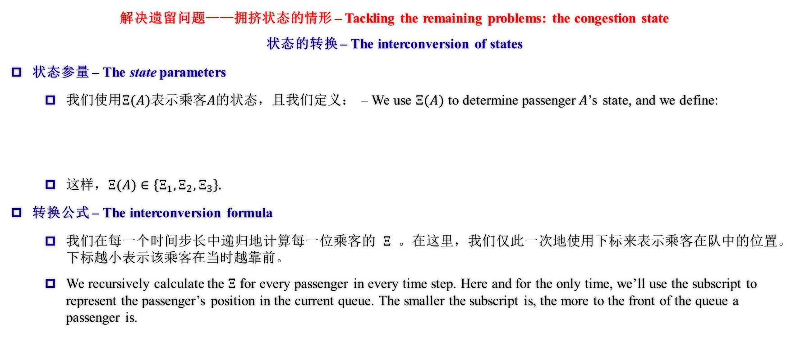
构建数学模型计算登机时间（拥挤状态） Devising a Model to Calculate Total Boarding Time (Under the Crowded States)
解决遗留问题——拥挤状态的情形 – Tackling the remaining problems: the congestion state
状态的转换 – The interconversion of states
状态参量 – The state parameters
我们使用$Ξ(A)$表示乘客$A$的状态，且我们定义： – We use $Ξ(A)$ to determine passenger$A$’s state, and we define:
这样，$Ξ(A)∈\left\{Ξ_{1}, Ξ_{2},Ξ_{3}\right\}.$
转换公式 – The interconversion formula
我们在每一个时间步长中递归地计算每一位乘客的$Ξ$。在这里，我们仅此一次地使用下标来表示乘客在队中的位置。下标越小表示该乘客在当时越靠前。
We recursively calculate the $Ξ$ for every passenger in every time step. Here and for the only time, we’ll use the subscript to represent the passenger’s position in the current queue. The smaller the subscript is, the more to the front of the queue a passenger is.

Slide 27
构建数学模型计算登机时间（拥挤状态） Devising a Model to Calculate Total Boarding Time (Under the Crowded States)
解决遗留问题——拥挤状态的情形 – Tackling the remaining problems: the congestion state
状态的转换 – The interconversion of states
转换公式 – The interconversion formula
我们使用了如下方式更新状态，达到效果 – We used the following method to update the states.
最终转换的效果如下。Below is shown the mechanism, which fits our flow chart as shown in the beginning.
不难发现，最终的关系仍然保持线性。It’s clear that the relationship remains linear.

Slide 28
构建数学模型计算登机时间（拥挤状态） Devising a Model to Calculate Total Boarding Time (Under the Crowded States)
解决遗留问题——拥挤状态的情形 – Tackling the remaining problems: the congestion state
状态的转换 – The interconversion of states
剔除公式 – Deleting from the queue
当乘客到达座位，我们通过将其剔除队列来更新以继续进行运算，不会影响到前述算法。
When a passenger reaches his seat, we delete him from the queue to update and continue with the calculations without affecting the previous algorithm.

Slide 29
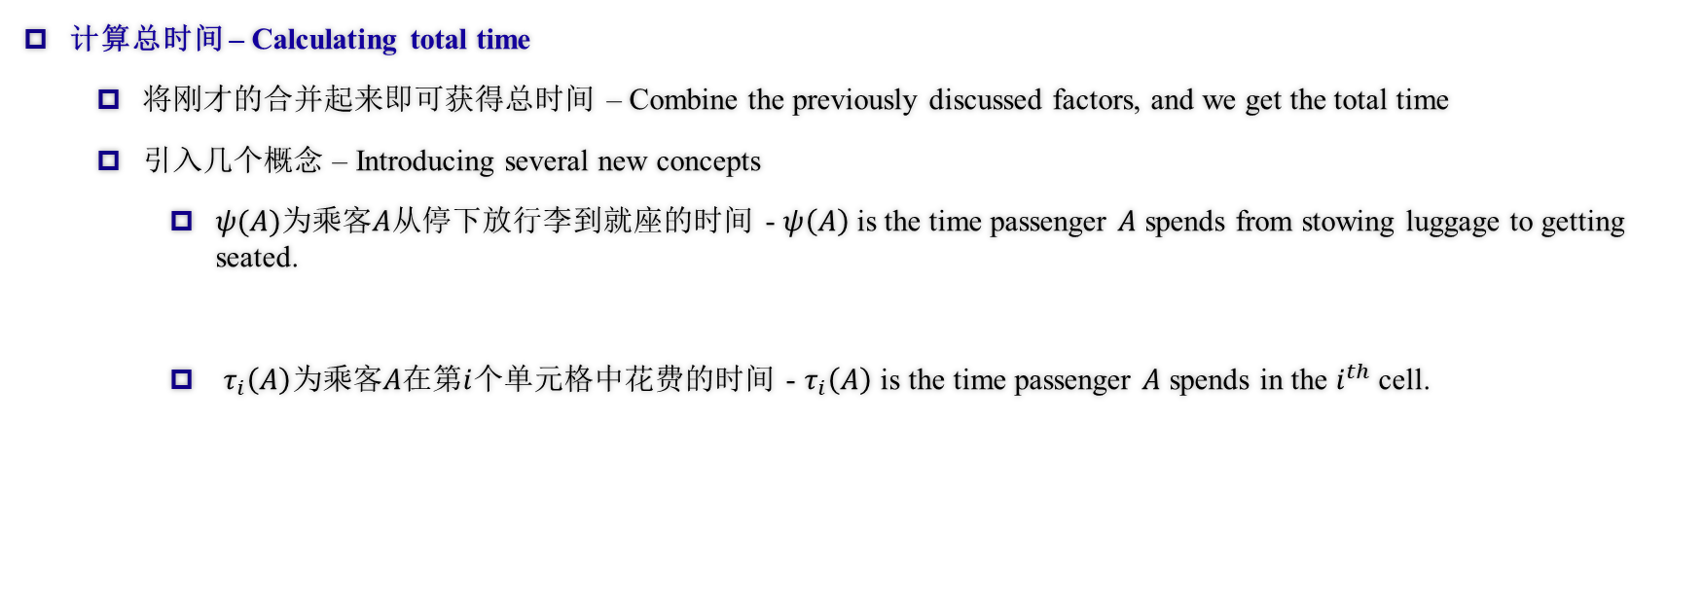
构建数学模型计算登机时间（总时间） Devising a Model to Calculate Total Boarding Time (Total time)
计算总时间 – Calculating total time
将刚才的合并起来即可获得总时间 – Combine the previously discussed factors, and we get the total time
引入几个概念 – Introducing several new concepts
$ψ(A)$为乘客$A$从停下放行李到就座的时间 - $ψ\left(A\right)$ is the time passenger $A$ spends from stowing luggage to getting seated.
$τ_{i}\left(A\right)$为乘客$A$在第$i$个单元格中花费的时间 - $τ_{i}\left(A\right)$ is the time passenger $A$ spends in the $i^{th}$ cell.

Slide 30
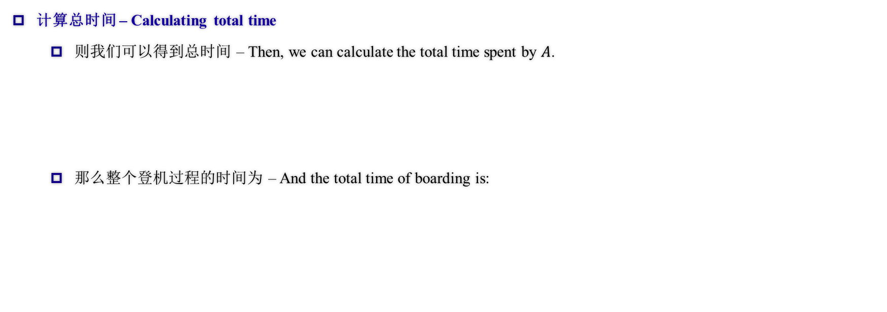
构建数学模型计算登机时间（总时间） Devising a Model to Calculate Total Boarding Time (Total time)
计算总时间 – Calculating total time
则我们可以得到总时间 – Then, we can calculate the total time spent by $A$.
那么整个登机过程的时间为 – And the total time of boarding is:

Slide 31
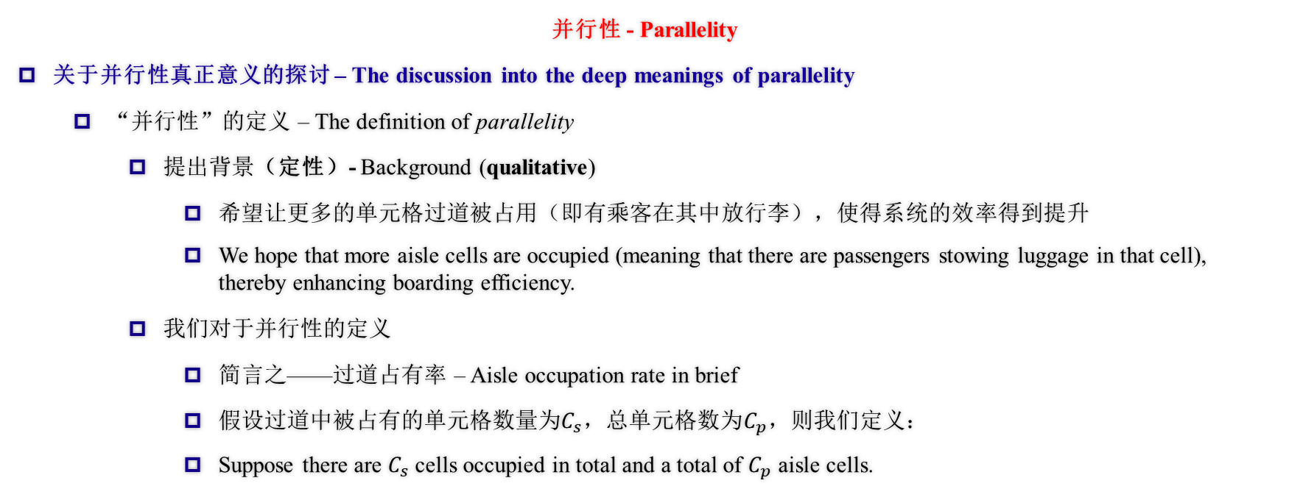
构建数学模型计算登机时间（并行性） Devising a Model to Calculate Total Boarding Time (Parallelity)
并行性 - Parallelity
关于并行性真正意义的探讨 – The discussion into the deep meanings of parallelity
“并行性”的定义 – The definition of parallelity
提出背景（定性）- Background (qualitative)
希望让更多的单元格过道被占用（即有乘客在其中放行李），使得系统的效率得到提升
We hope that more aisle cells are occupied (meaning that there are passengers stowing luggage in that cell), thereby enhancing boarding efficiency.
我们对于并行性的定义
简言之——过道占有率 – Aisle occupation rate in brief
假设过道中被占有的单元格数量为$C_{s}$，总单元格数为$C_{p}$，则我们定义：
Suppose there are $C_{s}$ cells occupied in total and a total of $C_{p}$ aisle cells.

Slide 32
构建数学模型计算登机时间（并行性） Devising a Model to Calculate Total Boarding Time (Parallelity)
并行性 - Parallelity
关于并行性真正意义的探讨 – The discussion into the deep meanings of parallelity
“模型基础”（半定量分析）- Model basis (semi-quantitative analysis)
前述计算表明乘客的速度遵循递推式，并且遵循线性模型的关系
Previous calculations infer that the velocities of passengers follow a recursion formula and that they follow a linear pattern.
而想让总时间变小，本模型中定义的“速度”需要尽量小
Therefore, to minimise total time, the velocity (the one defined in our model) should also be minimised.

Slide 33
构建数学模型计算登机时间（并行性） Devising a Model to Calculate Total Boarding Time (Parallelity)
并行性 - Parallelity
关于并行性真正意义的探讨 – The discussion into the deep meanings of parallelity
“模型基础”（半定量分析）- Model basis (semi-quantitative analysis)
因此希望让“速度”的增加次数尽可能小，或是尽可能长时间维持在最小值
That’s why we want the velocity to increase fewer times or maintain its minimum for an extended period of time.
所以希望过道的占用率更大，这样乘客能够保持更长时间（现实中的）的最大速度，直到所有在过道中的人再次开始放行李
So, by hoping the aisle has higher occupancy, passengers can maintain the maximum speed (in reality) until all the passengers in the aisle start stowing luggage again.
因此我们使用“过道占有率”来作为总时间的衡量指标
Therefore, we use aisle occupancy to measure total time.

Slide 34
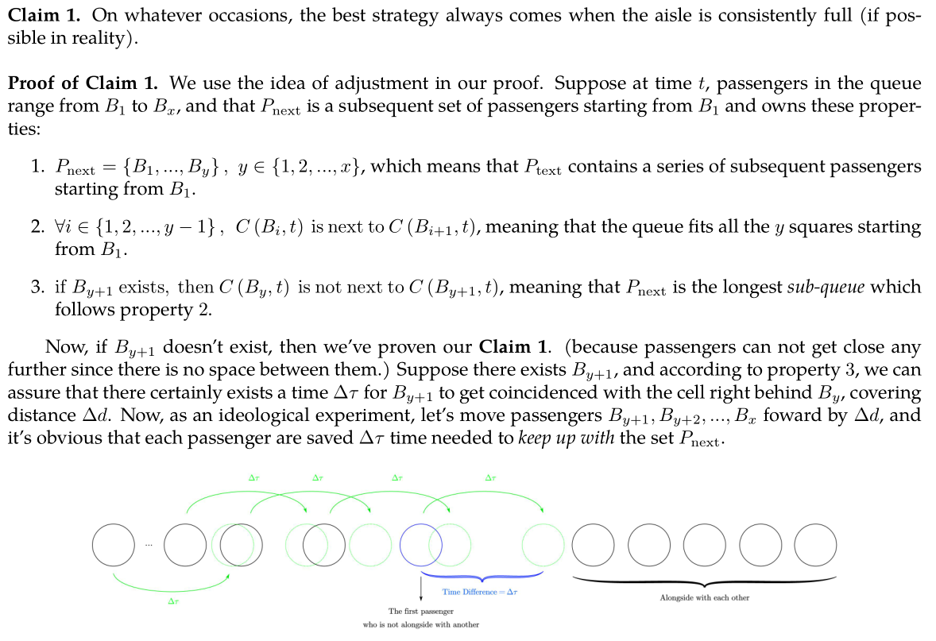
构建数学模型计算登机时间（并行性） Devising a Model to Calculate Total Boarding Time (Parallelity)
并行性 - Parallelity
关于并行性真正意义的探讨 – The discussion into the deep meanings of parallelity
数学推导（全定量分析）- Mathematical deduction (quantitative analysis)
结论1（满格的最优性）- Claim 1 (the optimality of all cells being occupied)
该结论从另一方面也验证了本模型的正确性。
This claim, on the other hand, also justified our model.
调整法结合理想状态分析
the adjustment method & analysis on idealistic circumstances
结论2将会在之后的多机型部分出现。
Claim 2 will appear later in the TETA and Flying Wing part.
论文所言的具体数学过程我们将不再赘述。
We’ll not elaborate on the essay-based strict proof.

Slide 35
离机与登机的等效性证明 Proof of Equality Between Boarding and Disembarking
对于每名乘客来说，其离机过程就是其登机过程的逆过程：其运动过程恰好完全相反，从取出行李，经过走廊到抵达飞机入口。
For each passenger, the disembarking process is the reverse of the boarding process: the motivation is quite the opposite, from getting the luggage out, going through the aisle, to reaching the aircraft entrance.
因此，由于过程相似，显然我们可以得到，离机的最佳策略和登机类似，也要让过道尽量被占用，以达到最高的并行性。
Thus, due to the similarity between both processes, it’s evident that the best disembarking strategy is identical to embarking: the aisles are maximally utilised in terms of parallelity.
然而，不同点是，在离机过程中，由于乘客都忙于取行李，根本不存在让位的可能（因为走廊被堵住）。因此，每一排上乘客的离机顺序就是简单的从外到内。由于离机时每一个走廊单元格都能被拿行李或缓慢行进的乘客占用，相当于乘客以理想方式排队，并行性高于登机，因此离机所需时间会短于登机。
However, the difference is that during disembarking, there’s no possibility of offering cells, for the aisle is blocked when passengers are getting the luggage out. Thus the disembarking sequence of each row is simply aisle to window. All the aisle cells can be occupied, passengers getting luggage out or walking slowly, the same as queuing in the ideal way, having higher parallelity than boarding, the time needed is shorter than boarding.

Slide 36
满意度指数 Satisfaction Index
对于任意一种方案，乘客可能会由于某些因素而感到不满意。根据我们对现实生活中坐飞机的经历，有这样几个主要因素：
For whatever method, passengers may feel unsatisfied due to various reasons. According to our experience in real life, here are some significant factors:
排队时间 Queuing time
让座时间 Time offering seats
同一排内乘客登机时间的标准差 The standard variance of the boarding time of the passengers in the same row
这个因素的引入是为了考虑坐在同一排的同行（一般是家庭）的旅客被拆散登机带来的不满意度
This factor was introduced to consider the dissatisfaction of the split of the fellow passengers (usually families) in the same row
这个因素因为误删没有在论文中显示，后文突然出现可能会显得突兀
This factor was unexpectedly unshown in the essay, so it may be abrupt when appearing later
总不满意度是这三个因素的加权和，三个因素的权值分别是1，250与10
The total dissatisfaction is the weighted sum of the three factors, the weight respectively 1, 250 and 10.

Slide 37
满意度指数 Satisfaction Index
为什么是1，250，10三个数？
Why 1, 250 and 10?
1是为了标准化
1 is for standardisation
其他数字是为了统一三个因素的量级（显然排队的时间长于让座的时间但让座引起的不满更大），同时第三个因素的影响也很大，但同行旅客占比较低
The other figures are for uniting the magnitudes (obviously the time queuing is longer than the time offering seats, but the latter is more dissatisfying); the third factor is also essential, but there’re few fellow passengers
较为统一的量级可以使最终的总满意指数综合这三项指标，而不是偏重其中某一项
Once united the magnitudes, the dissatisfaction index can rather equally reflect the three aspects of passengers’ satisfaction.

Slide 38
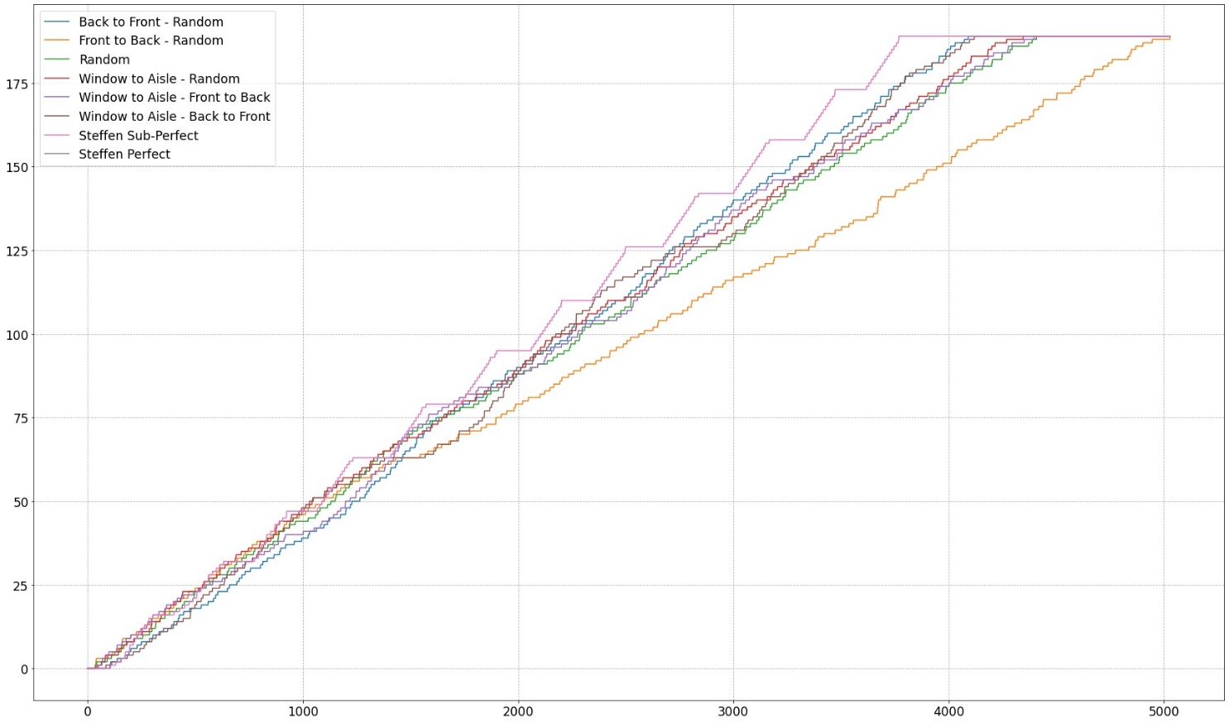
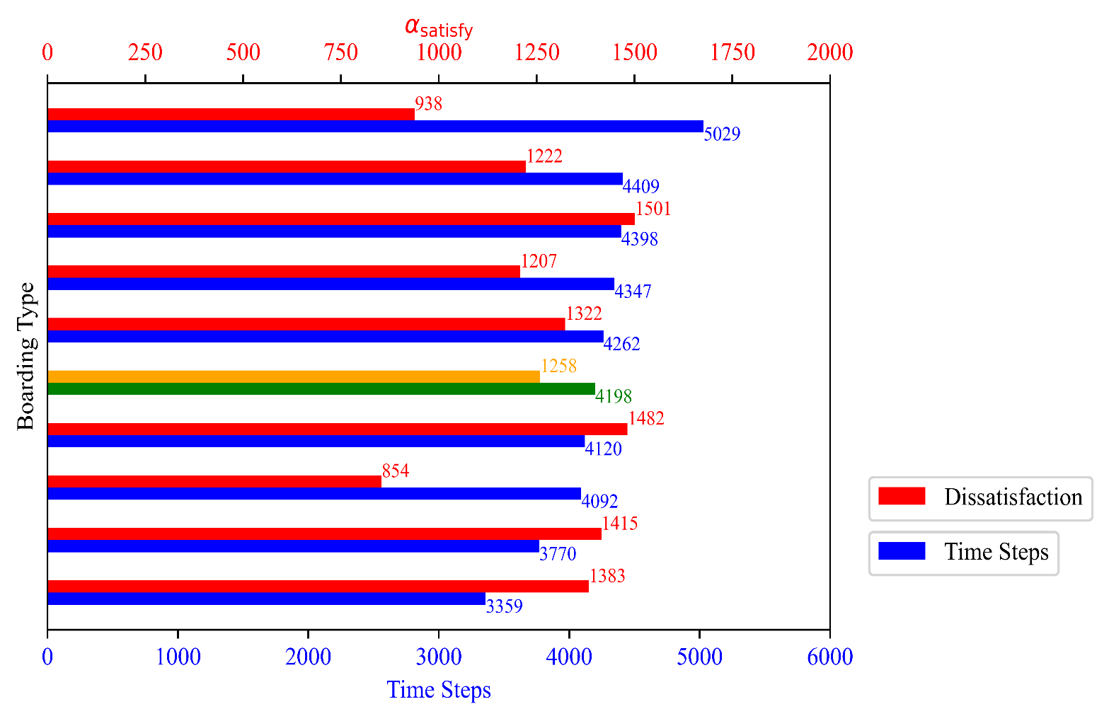
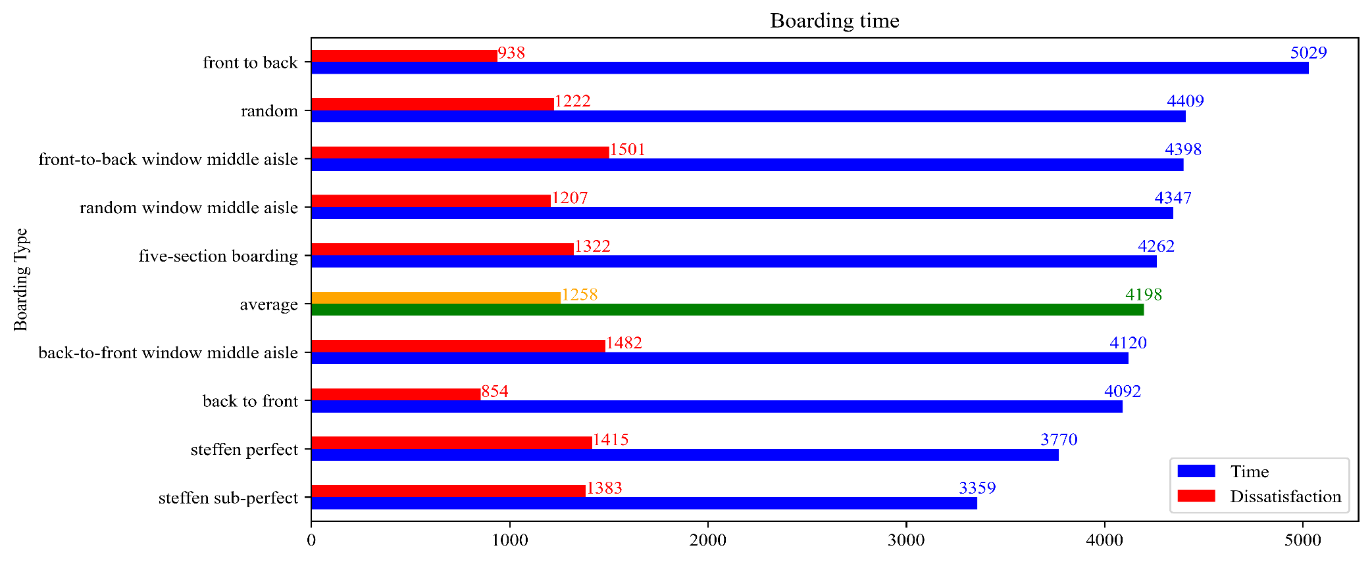
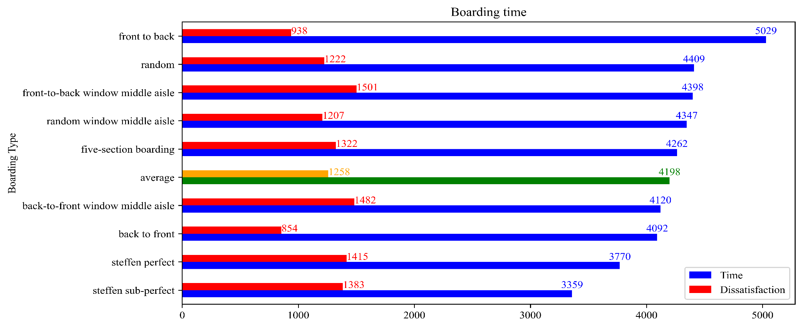


模拟结果 Results of Simulation

Slide 39
敏感度分析 Sensitivity Analysis
如何对我们的模型进行敏感度分析？
How to conduct a Sensitivity Analysis on Our Model?
使用拟合程度进行定量衡量
Use Compliancy Index to measure in concrete figures
对改变的可预测性
Predictability of Changes
结论与模型证明的变化关系
Relationship proved by Claims and Our Model

Slide 40
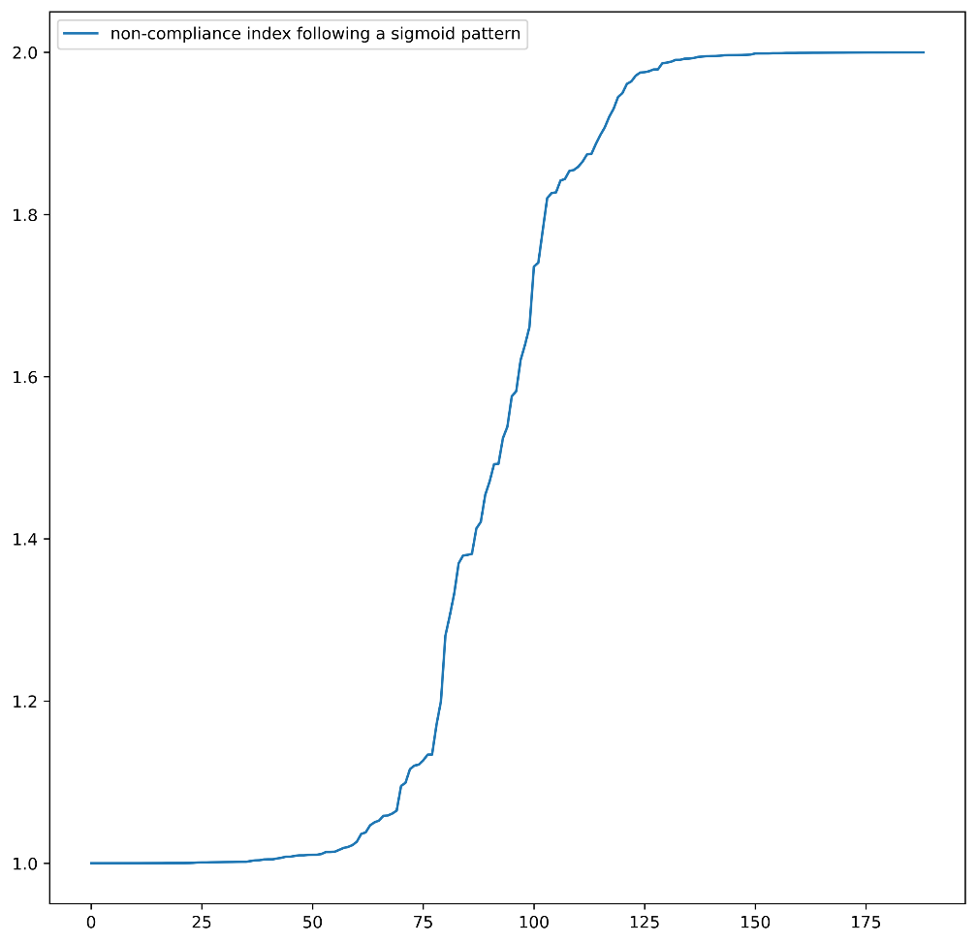
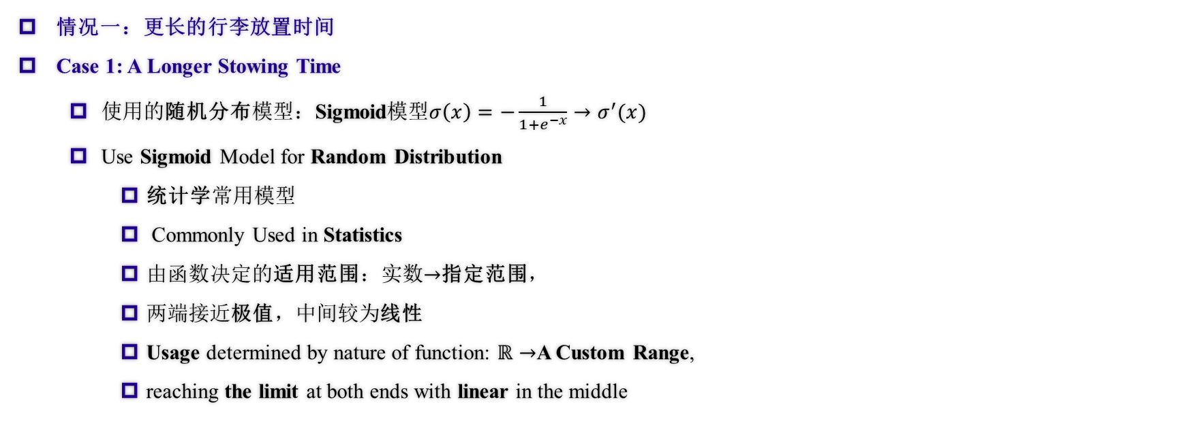
敏感度分析 Sensitivity Analysis
情况一：更长的行李放置时间
Case 1: A Longer Stowing Time
使用的随机分布模型：Sigmoid模型$σ\left(x\right)=−\frac{1}{1+e^{−x}}→σ^{′}(x)$
Use Sigmoid Model for Random Distribution
统计学常用模型
Commonly Used in Statistics
由函数决定的适用范围：实数$→$指定范围，
两端接近极值，中间较为线性
Usage determined by nature of function: $ℝ→$A Custom Range,
reaching the limit at both ends with linear in the middle
图：Sigmoid模型范例
Fig. Sigmoid Model Demonstration

Slide 41
敏感度分析 Sensitivity Analysis
情况一：更长的行李放置时间
Case 1: A Longer Stowing Time
如何区分稳定和不稳定？（总体尺度上）
How to distinguish between Stable and Unstable? (Overall Timestep)
稳定：线性图像
Stable: Linear Graph
不稳定：无明显规律
Unstable: No Obvious Relationship
方差（差异化程度）的图像
The Graph of Variance
稳定：先为上凸函数（变化率逐渐递减），后为线性
Stable: Rate of Changing Decrease followed by Linear
不稳定：无线性阶段
Unstable: No Linear State

Slide 42
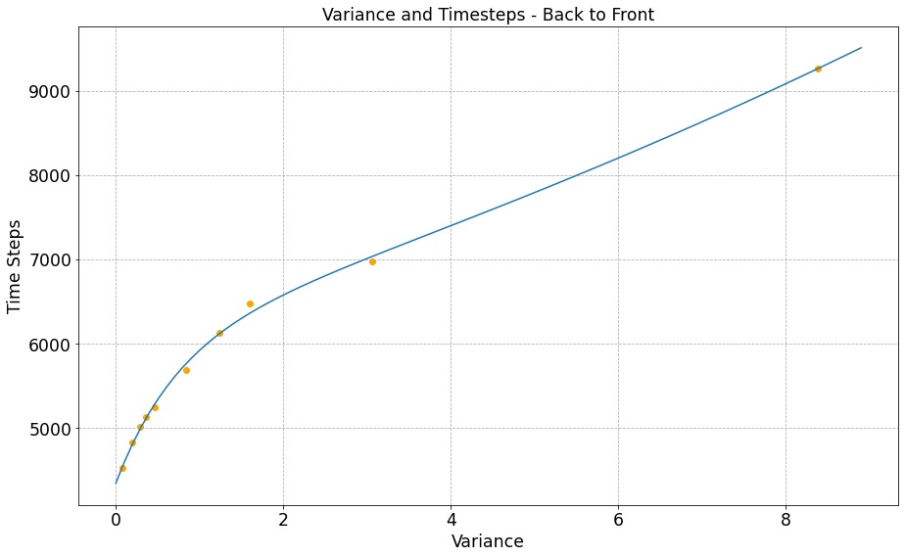
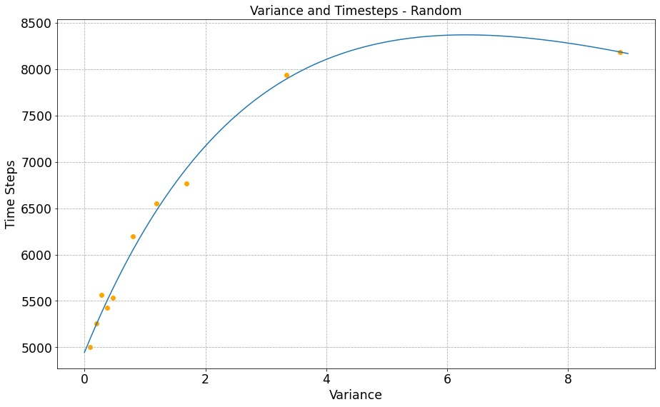
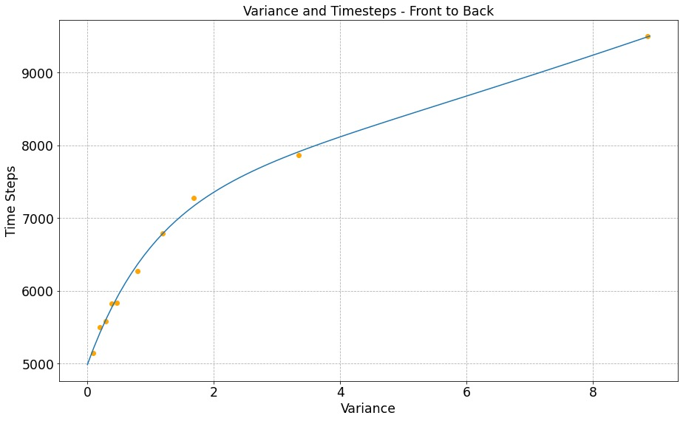
敏感度分析 Sensitivity Analysis
情况一：更长的行李放置时间
Case 1: A Longer Stowing Time
图：放置行李时间影响比较（方差）
Fig. Comparison on Longer Stowing Time, Variance

Slide 43
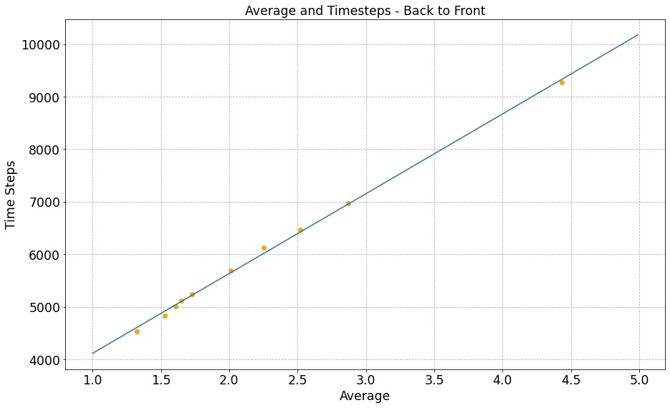
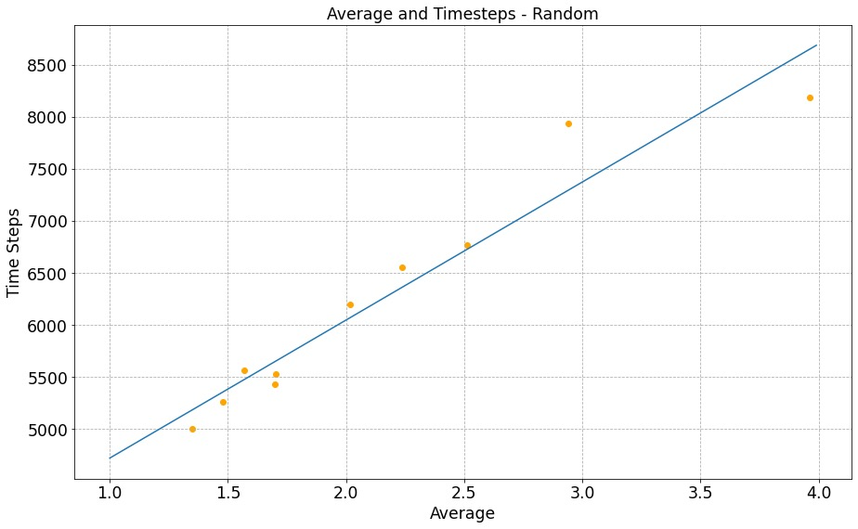
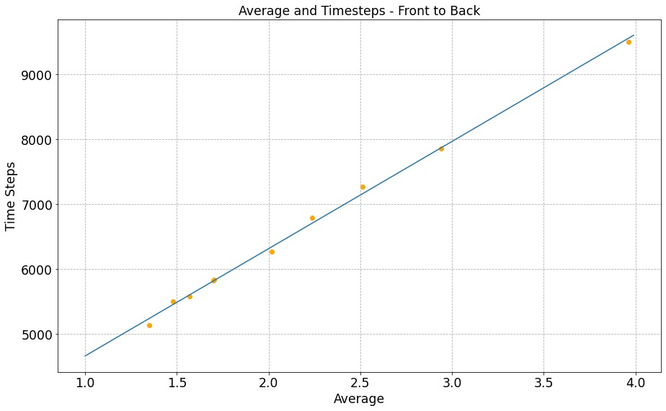
敏感度分析 Sensitivity Analysis
情况一：更长的行李放置时间
Case 1: A Longer Stowing Time
随机登机敏感度较高，由前到后登机敏感度较低
Random boarding is the most sensitive while Front-to-Back method seems totally not sensitive
图：放置行李时间影响比较（总时间）
Fig. Comparison on Longer Stowing Time, Overall Time

Slide 44
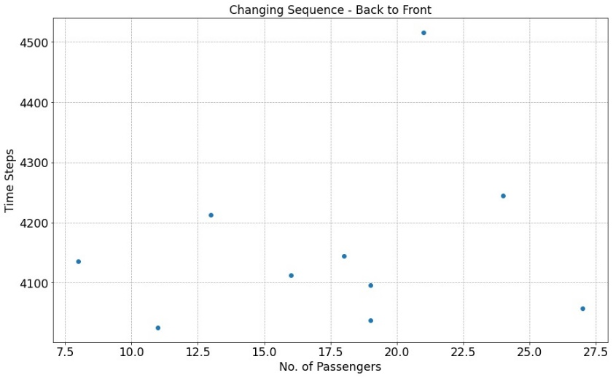
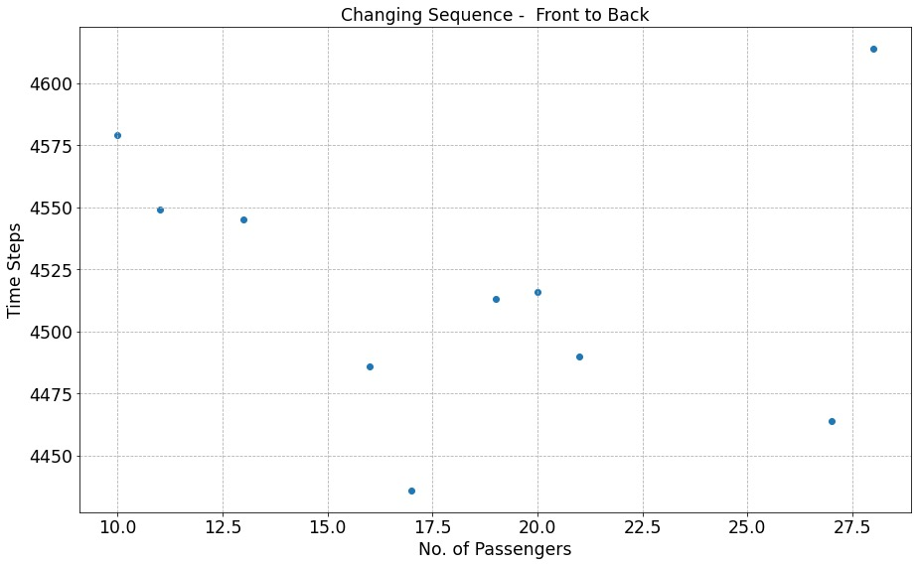
敏感度分析 Sensitivity Analysis
情况二：插队
Case 2: Queue Jumping
两个方案均为敏感方案，会对结果造成巨大的影响
Both Methods are Sensitive which makes a Big Impact on Total Results
图：插队影响比较
Fig. Comparison on Queue Jumping

Slide 45
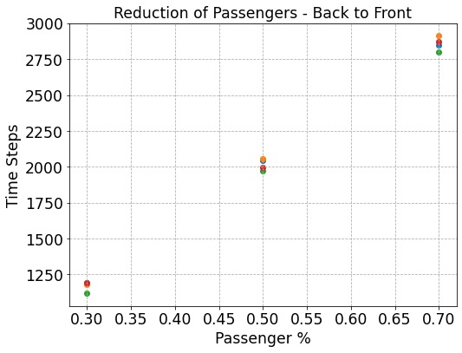
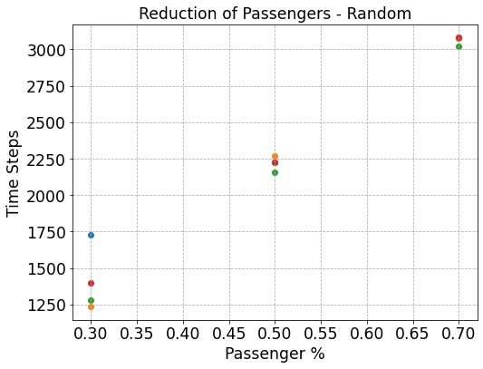
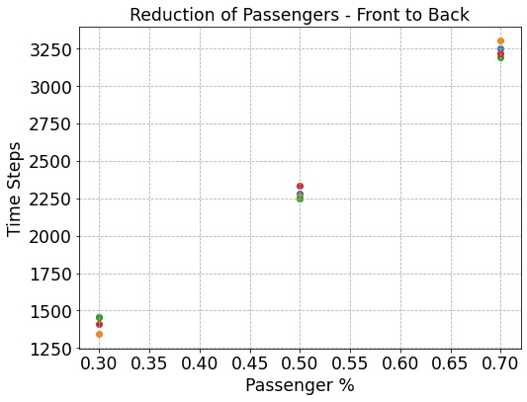
敏感度分析 Sensitivity Analysis
情况三：乘客数量的减少
Case 3: Reduction of Passengers
随机登机最为敏感（点的分布最远），由后到前登机依然十分稳定
Random Boarding is the most Sensitive (Furthest Distribution of Points), Back-to-Front Method still not so sensitive
图：乘客人数减少影响比较
Fig. Comparison on Reducing Passengers

Slide 46
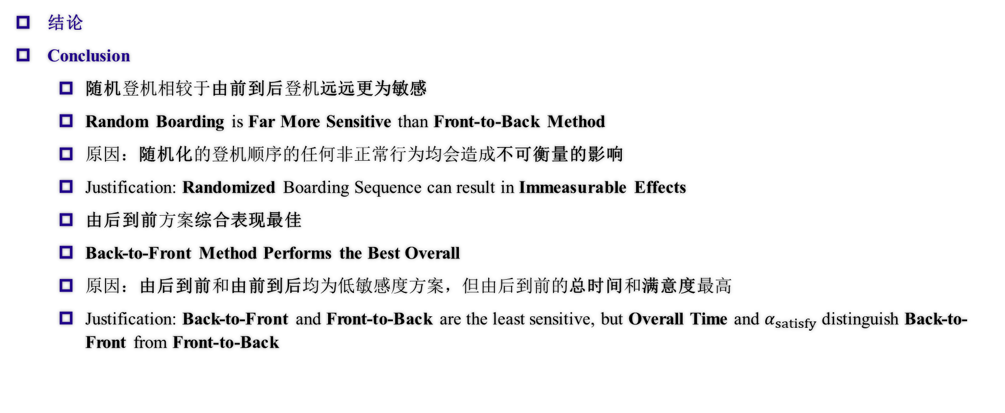
敏感度分析 Sensitivity Analysis
结论
Conclusion
随机登机相较于由前到后登机远远更为敏感
Random Boarding is Far More Sensitive than Front-to-Back Method
原因：随机化的登机顺序的任何非正常行为均会造成不可衡量的影响
Justification: Randomized Boarding Sequence can result in Immeasurable Effects
由后到前方案综合表现最佳
Back-to-Front Method Performs the Best Overall
原因：由后到前和由前到后均为低敏感度方案，但由后到前的总时间和满意度最高
Justification: Back-to-Front and Front-to-Back are the least sensitive, but Overall Time and $α_{satisfy}$ distinguish Back-to-Front from Front-to-Back

Slide 47
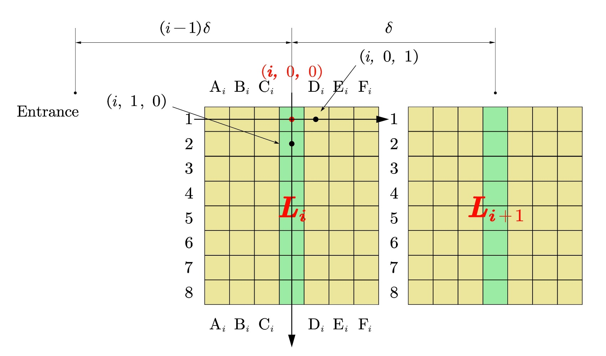
应用到不同机型（坐标划分） Application to Different Aircrafts (The division of coordinates)
Flying Wing Aircraft
采用了三维坐标形式
We adopted three-dimensional coordinates.
将每一块看作互相独立的部分
We see every block as independent parts
Main Aisle Cells
Block Aisle Cells
图 Flying Wing 坐标划分
Division of coordinates in Flying Wing

Slide 48
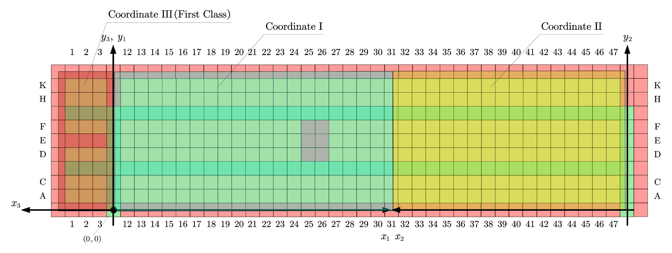
应用到不同机型（坐标划分） Application to Different Aircrafts (The division of coordinates)
图 TETA 坐标划分
Division of coordinates in TETA

Slide 49
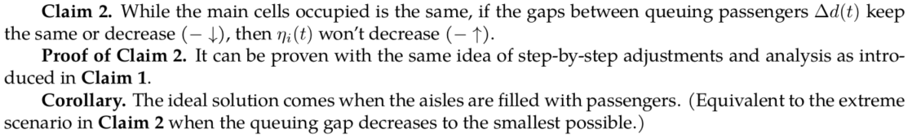
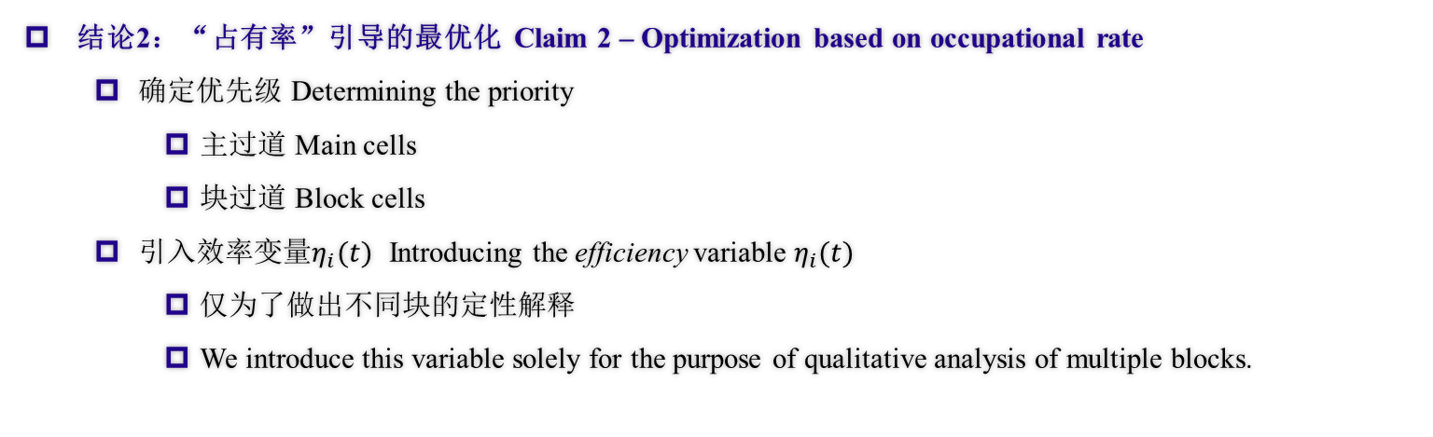
应用到不同机型（准备部分） Application to Different Aircrafts (Preparation)
结论2：“占有率”引导的最优化 Claim 2 – Optimization based on occupational rate
确定优先级 Determining the priority
主过道 Main cells
块过道 Block cells
引入效率变量$η_{i}(t)$ Introducing the efficiency variable $η_{i}(t)$
仅为了做出不同块的定性解释
We introduce this variable solely for the purpose of qualitative analysis of multiple blocks.

Slide 50
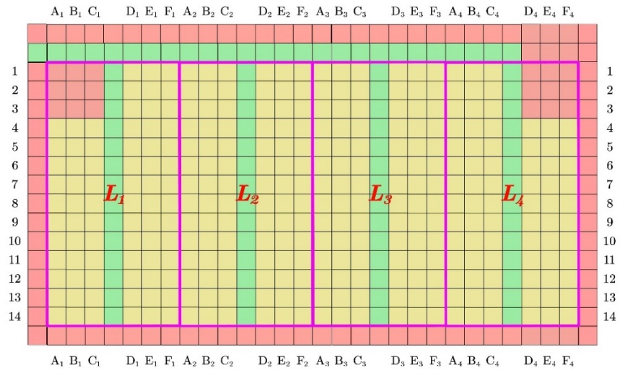


应用到不同机型 Application to Different Aircrafts
图 最优登机步骤流程图
Fig. Flow chart for the optimal boarding method
两种区块划分
Two block division schemes

Slide 51


应用到不同机型 Application to Different Aircrafts
图 理想登机方案
Fig. Ideal Boarding Scheme

Slide 52

应用到不同机型 Application to Different Aircrafts
结论 Conclusion
显然，由于外侧组的乘客可能会堵住主过道影响内侧组的乘客登机，为了确保过道的使用效率，我们应当让内侧组的乘客先登机。同时，为了防止内侧组有人就座之后带来的空单元格，我们决定在外侧组的一些乘客登机之后再安排几个内侧组的乘客，用来补齐这些空单元格。
Obviously, passengers in the outer groups may block the main aisle and influence inner group passengers’ boarding, so we should first board inner group passengers to ensure aisles' efficiency. Meanwhile, to prevent empty cells caused by seated inner group passengers, we decided to arrange a few inner group passengers after some outer group passengers have boarded, to fill up the empty cells.

Slide 53

应用到不同机型 Application to Different Aircrafts
结论 Conclusion

Slide 54
优缺点 Strengths & Weaknesses
优点
准确性
多样性
有效性
缺点
复杂性
难于操作
Strengths
Accuracy
Universality
Efficiency
Weaknesses
Complexity
Difficult to operate

Slide 55

给航空公司的建议信 A Letter to Airline Executives
两个主要因素 Two factors:
人性化 Hominization
高效 Efficiency
三条有效建议 Three suggestions:
防止主过道拥堵
Avoid blocks in general aisles
为行李提供足够空间
Provide enough space for luggage
防止不必要的插队
Prevent unnecessary queue-jumping

